Slide 1

Georgetown Capstone
Cohort 14
Booksville Team
Suchit Sharma
Elsa Abebe (Team Spokesperson)
Kamal Rangavajhula
Wesenyelew Sima

Slide 2





ROADMAP
Motivation and Hypothesis
Data Source
Data Ingest and Wrangling
Exploratory Data Analysis
Feature Selection
Model Evaluation
Result
Conclusion

Slide 3


Slide 4


Slide 5

Hypothesis
Predict future sale price of a book based on historic Amazon sale data

Slide 6

Data Source
Data Collection Agency
Maintains price history of all products on Amazon
Based in Germany
Provides data via tokenized API

Slide 7
Architecture
Keepa
Product Sale History
PostgreSQL
Data Ingest
Psycopg2 / SQL
Data Wrangling
Pandas
Feature Selection
Scipy / Numpy / Scikit-learn
Model Evaluation
Scikit-learn / Math
Hyperparamerter Tuning
Scikit-learn
Reporting and Visulaization
Yellowbrick / Seaborn

Slide 8
Data Ingest
<Elsa working on this topic>

Slide 9
Data Wrangling
Initial Data set:
100,192 records and 79 columns
No Price – Calculated using three columns
Removed columns with 50%+ null values
Replace categorical nulls with Unknown
Converted to appropriate data types
Dropped columns no relevant information
Dropped columns with identical information as other columns.
Pre-EDA Data Set:
99,600 records and 49 columns

Slide 10
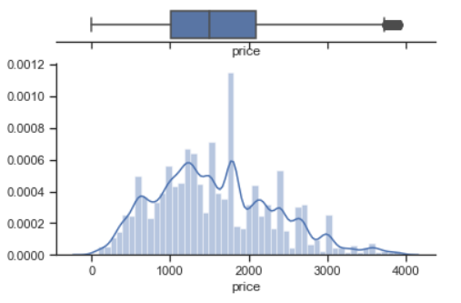
Exploratory Data Analysis
Categorical Group Reduction
Identified categorical columns with long tail of unique but similar values
Replaced similar values (‘Middle English’) with superset values (‘English’)
Column values with < 10 frequency were grouped into ‘Others’
15 Categorical Columns encoded using LableEncoder
Outliers identified using Tukey’s fences and dropped
Low variance features identified using VarianceThreshold method and dropped

Slide 11
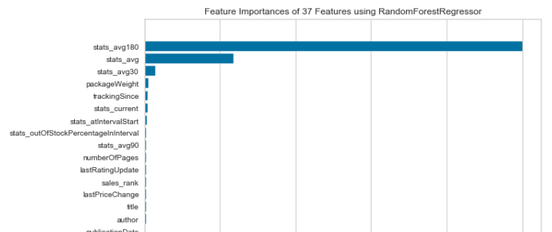
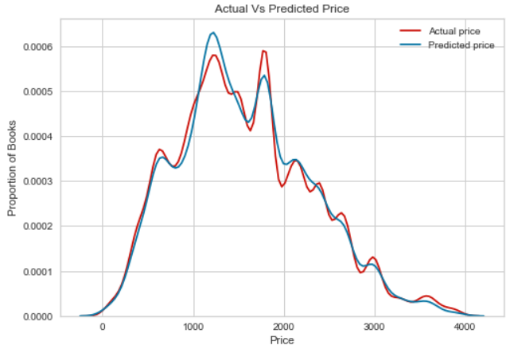
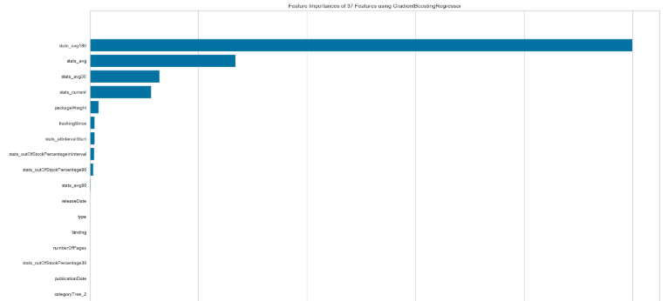
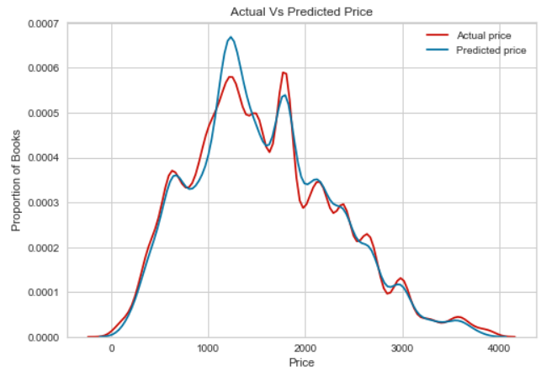
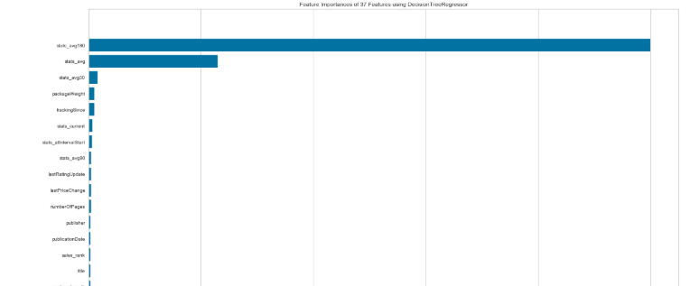
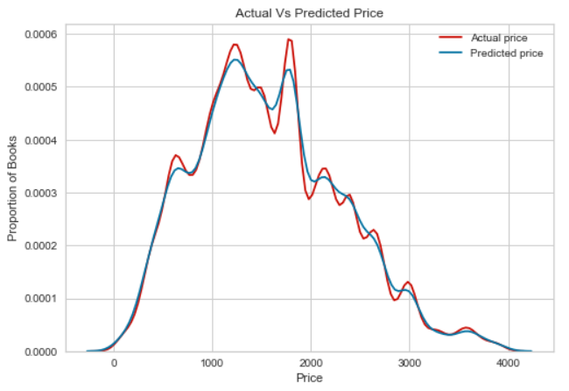
Feature Selection
Random Forest
Gradient Boosting
No Insignificant
Features
Decision Tree

Slide 12
Model Evaluation

Slide 13
Hyperparameter Tuning

Slide 14
Result

Slide 15
Conclusion

Slide 16
Questions

Slide 17


